Slide 1
Getting the most out of BTRFS
Rick Ashford Manager – US Sales Engineering West rick.ashford@suse.com
@darthzen
Rodolfo Bejarano Sales Engineer rbejarano@suse.com
@rb_suse
Jeff Mahoney
Team Lead, Kernel File Systems
jeffm@suse.com

Slide 2


Agenda
Welcome and Introductions
Overview – What is BTRFS and what can it do for you?
Administration of a BTRFS filesystem
Basic Features Setting up multi-disk systems, compression, hot add/remove
Advanced Features Subvolumes, Quotas, Send/Receive
Notes:
(Review agenda specific to your city – SLIDE SHOULD BE UPDATED TO REFLECT SPECIFIC CITY AGENDA)
Today we are going to start off with a look at the Digital Transformation that is happening and what that means for you. Here we want to discuss your infrastructure foundation, ensuring that you build a plan with a flexible platform, so that you can ensure it will work for you tomorrow.
We will break for lunch and come back to hear from our partner XXXX talking about YYYYY
Then, we will dive into how you can bring the different pieces of as a Service to your customers with software-defined infrastructure solutions.
Next, we will shift gears to talk about improving your agility using an open DevOps approach, improving how application services are delivered.
[transition] So, let’s get started with the digital transformation and what that means to you…
<number>

Slide 3
Overview
<number>

Slide 4
Overview
History
Started development in 2007 by Chris Mason
Feature-comparable to ZFS
SUSE
2010 - Technical preview in SLES 11 SP1
2012 - Fully supported in SLES 11 SP2
2014 - Default filesystem in SLES 12
<number>

Slide 5
What’s so great about it?
<number>

Slide 6
Overview
What’s so great about it?
16 Exabyte maximum size
Instantaneous snapshots
Logical separation via subvolumes
Automatic checksums on data and metadata
Compression (zlib and LZO)
Integrated multiple device support (Pooling/Striping/Mirroring)
SSD aware
<number>

Slide 7
Overview
What’s so great about it?
Online filesystem defragmentation
In-place conversion of existing ext3/4 file systems
Seed devices.
Subvolume-aware quota support
Efficient incremental filesystem mirroring
Batch deduplication
<number>

Slide 8
How does it work?
<number>

Slide 9
EXT2/3/4
<number>

Slide 10

Overview
ExtX
<number>

Slide 11

Overview
ExtX Modify
<number>

Slide 12
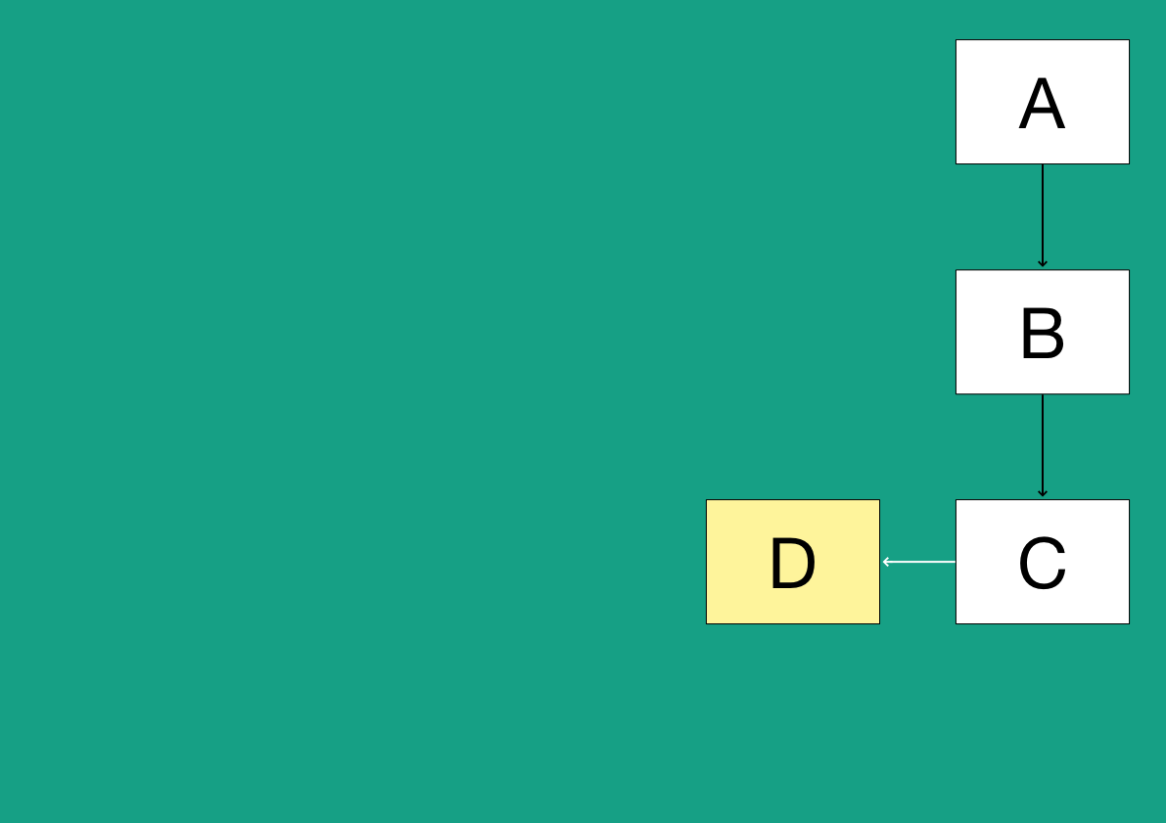
Overview
ExtX Insert
<number>

Slide 13
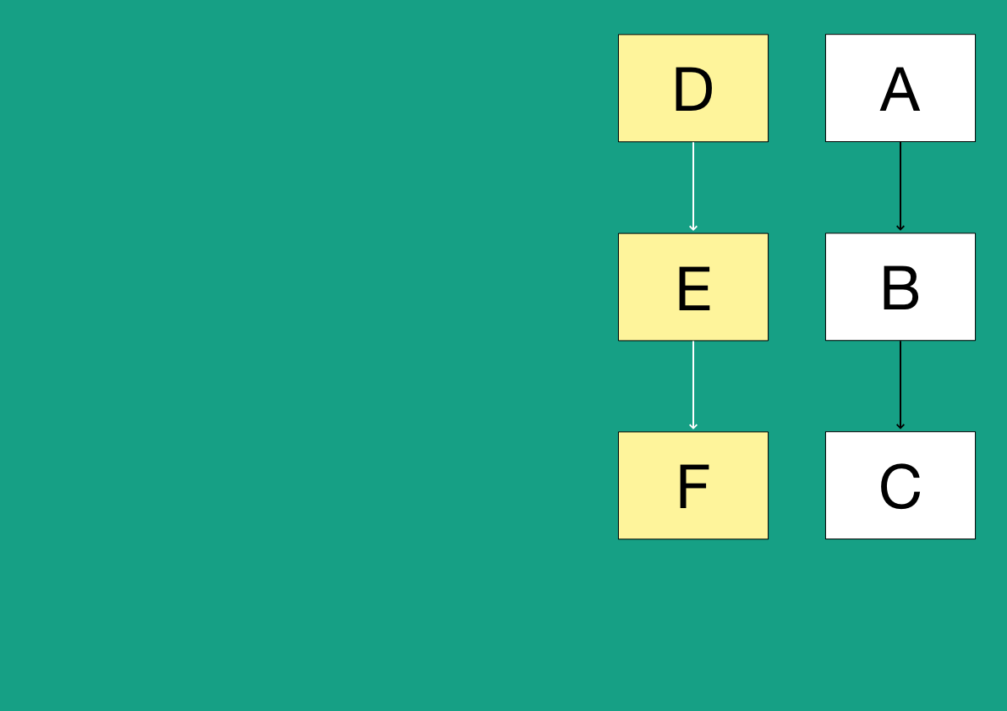
Overview
ExtX Copy
<number>

Slide 14
BTRFS
<number>

Slide 15
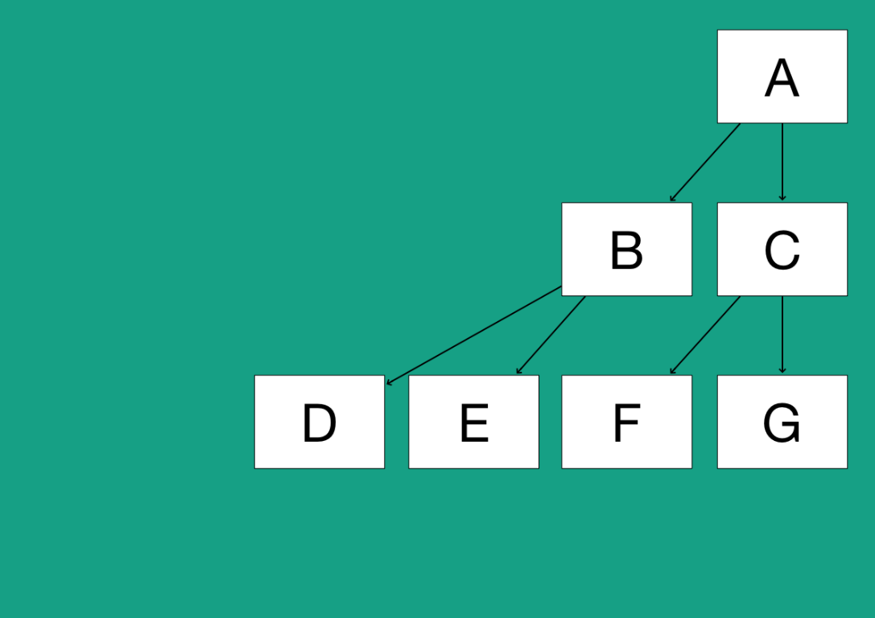
Overview
B-Tree Structure
<number>

Slide 16
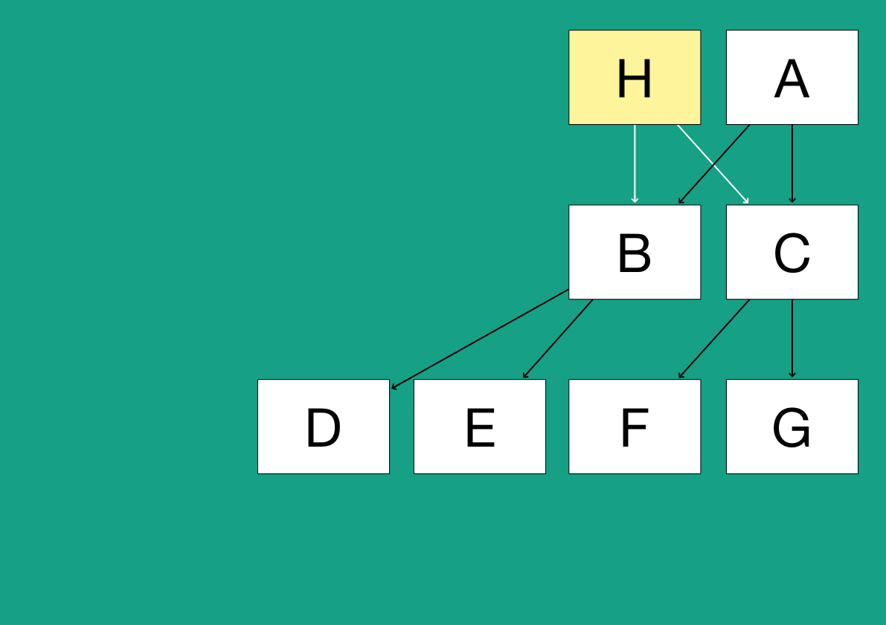
Overview
Copy
<number>

Slide 17
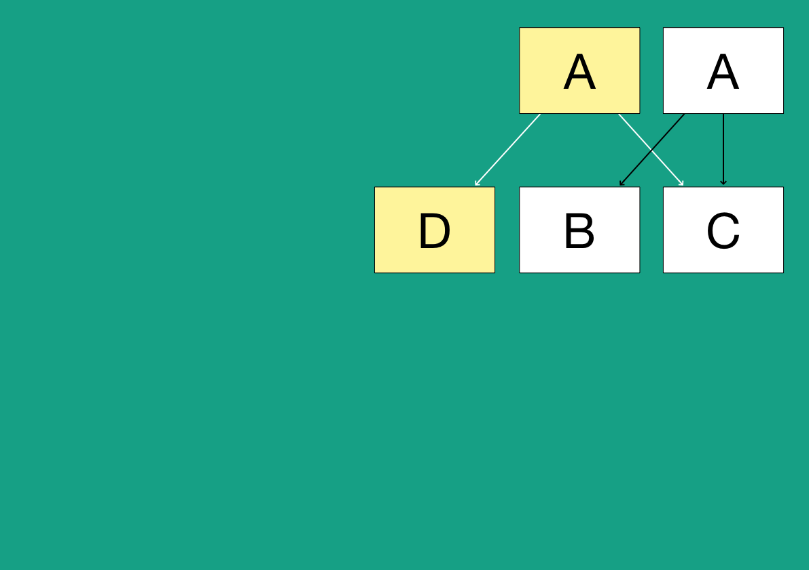
Overview
Modify
<number>

Slide 18

Overview
Insert
<number>

Slide 19
Feature | SLES 11 SP4 | SLES 12 GA | SLES 12 SP1 | SLES 12 SP2
Copy on Write | + | + | + | +
Snapshots/Subvolumes | + | + | + | +
Metadata Integrity | + | + | + | +
Data Integrity | + | + | + | +
Online Metadata Scrubbing | + | + | + | +
Manual Defragmentation | + | + | + | +
Out-of-band Deduplication | + | + | + | +
Quota Groups | + | + | + | +
Metadata Duplication | + | + | + | +
Multiple Devices | – | + | + | +
RAID 0 | – | + | + | +
RAID 1 | – | + | + | +
RAID 10 | – | + | + | +
Hot Add/Remove | – | + | + | +
Compression | – | – | + | +
Big Metadata Blocks | – | + | + | +
Skinny Metadata | – | + | + | +
Send Without File Data | – | + | + | +
Send/Receive | – | – | – | +
Fallocate with Hole Punch | – | – | – | +
Supported Features
<number>

Slide 20
Overview
Unsupported Features
RAID 5/6
Automatic defragmentation
In-band deduplication
Device replace
Seeding devices
Inode cache
<number>

Slide 21
BTRFS integration with SLES

Slide 22
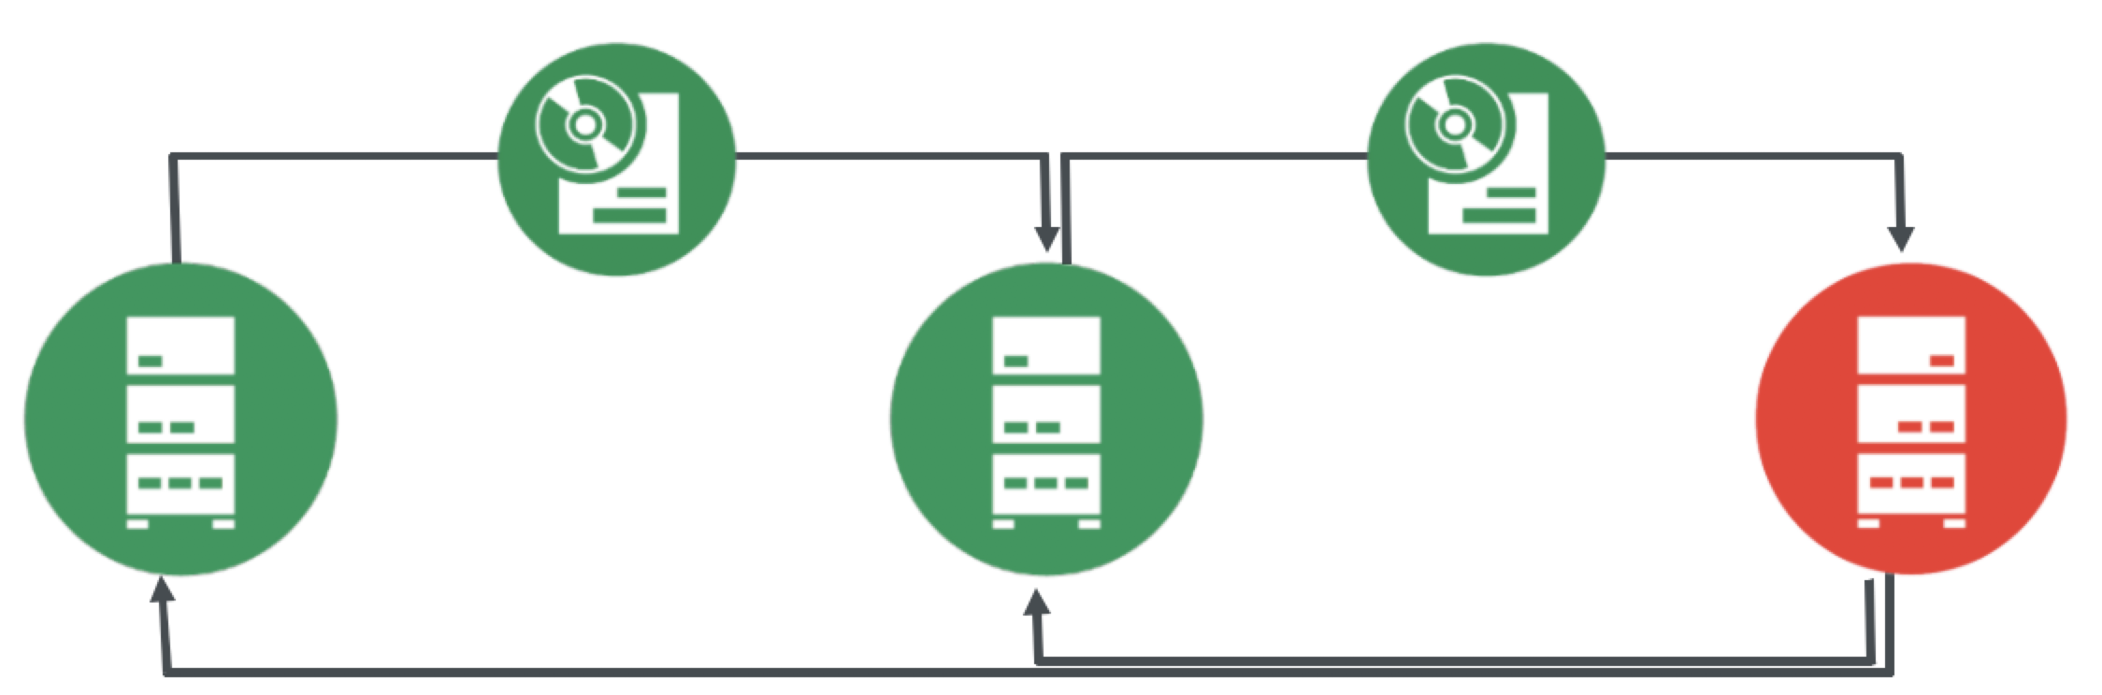
Undo OS Changes: Full System Rollback
Rollback to a good state with one click
Support for service pack rollback
Support for kernel upgrade
Based on btrfs and Snapper, bootloader integration
Reduce Downtimes
Planned
Unplanned
Full system rollback is a feature in SUSE Linux Enterprise Server 12. SUSE Linux Enterprise Server 11 SP2 and later provide a similar snapshot and rollback feature, without bootloader integration.
Notes:
With the move to SLES12 – SUSE has changed the default root file system to btrfs. The result – a reduction in both planned and unplanned downtime. Btrfs was initially introduced with full production support in SLES11 SP2, Feb 2012. Over the past five years, we have ramped up support, worked with customers and the upstream community to refine the implementation and tooling. By combining btrfs, snapper, and bootloader integration – we now have a fully functional system rollback solution.
<number>

Slide 23
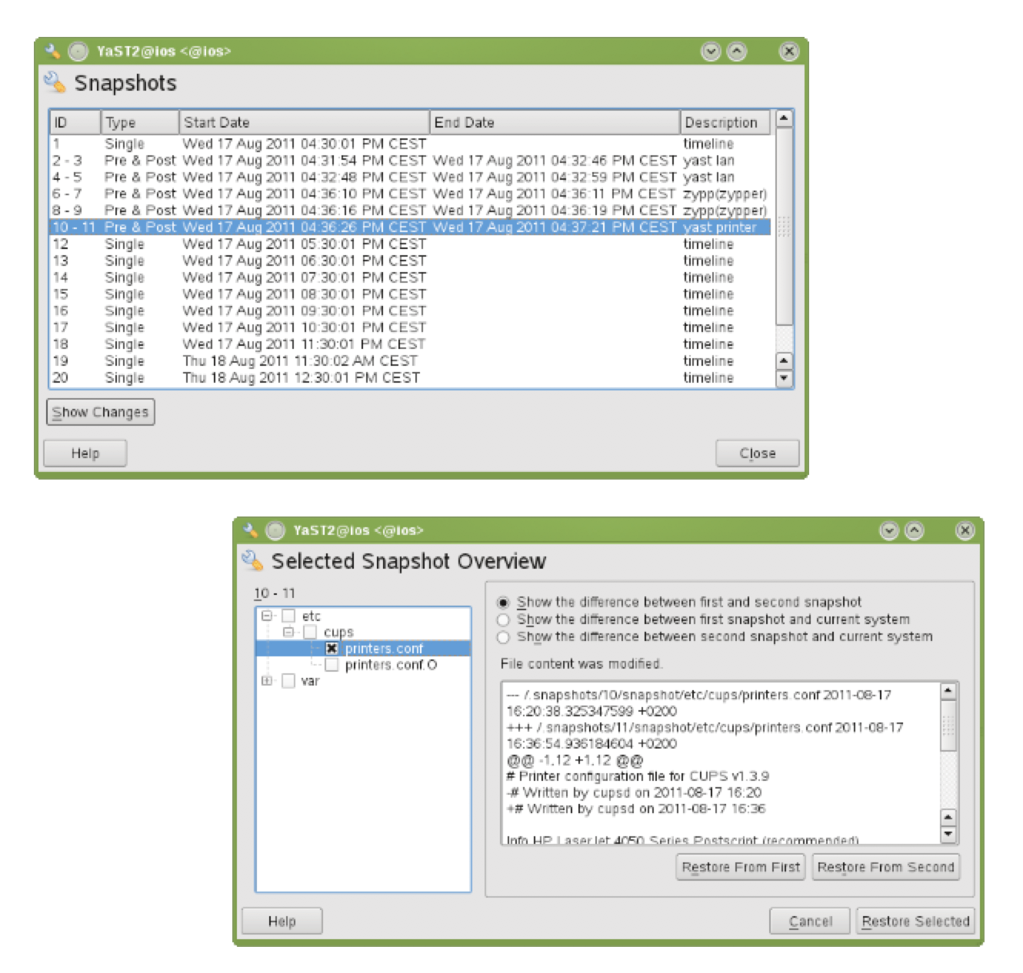
Snapshot / Rollback Overview
Manage snapshots using Snapper
Full rollback for SLE12
RPM package updates
Service pack updates
Admin changes
Kernel / initrd (initramfs)
No rollback of
Customer data: “/home,” if on own partition (default)
System data (/var/log) (independently snapshotted subvolumes)
www.snapper.io
Notes:
Snapshots are controlled by snapper. Snapper is responsible for taking triggered pre-post operation snapshots (YAST/zypper) and timeline snapshots (tracking deltas.)
Snapshots can be aliased to identify the command or change window executed. They can also be marked important. Snapshot retention can also be controlled, looking at time and number of snapshots being retained.
Rollback can be single file, snapshot, or full system – depending on the desired recovery point.
<number>

Slide 24
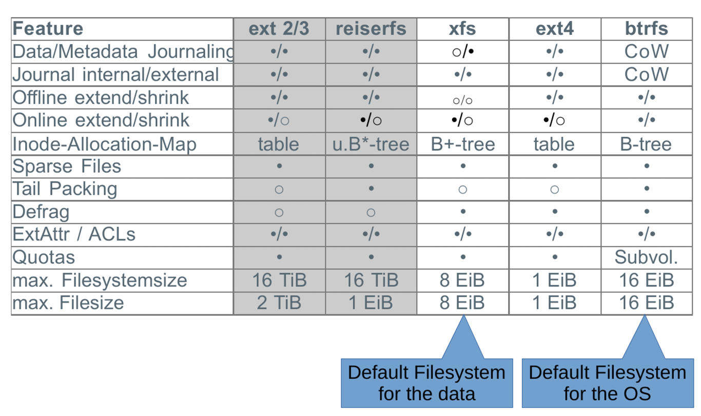
Major Linux (Local) Filesystems SUSE Linux Enterprise 12
Notes:
Default root filesystem is btrfs
Default data filesystem is XFS
Full ext[2-3-4] filesystem support is also available.
SUSE will support ext3, ext4, and XFS for root filesystem
Depending on the use case – the question to ask is whether the filesystem would benefit from using snapshots.
<number>

Slide 25
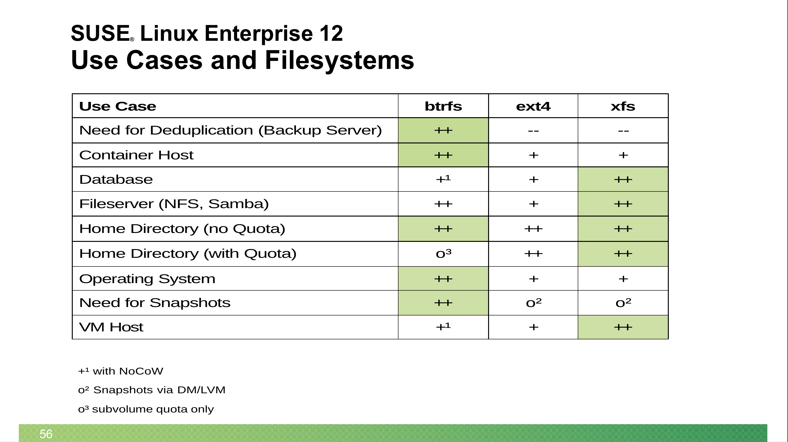
Use Cases and Filesystems SUSE Linux Enterprise 12
Notes:
Looking at filesystem capabilities across btrfs, ext4, and xfs– here are a few use cases to consider. In some cases, the No Copy on Write mount option should be used with btrfs to prevent fragmentation of data (VM Host / Virtual machine image store.)
<number>

Slide 26
Administration
<number>

Slide 27
Administration
btrfsprogs
btrfs
btrfs-convert
btrfs-image
btrfsck
btrfstune
<number>

Slide 28
Administration
btrfsprogs
btrfs
btrfs
btrfs-convert
btrfs-image
btrfsck
btrfstune
Toolbox for managing BTRFS filesystems.
<number>

Slide 29
Administration
btrfsprogs
btrfs-convert
btrfs
btrfs-convert
btrfs-image
btrfsck
btrfstune
Performs in-place conversion of ext3/4 and Reiser filesystem to btrfs.
Fully reversible
<number>

Slide 30
Administration
btrfsprogs
btrfs-image
btrfs
btrfs-convert
btrfs-image
btrfsck
btrfstune
Creates and restores filesystem images
<number>

Slide 31
Administration
btrfsprogs
btrfsck
btrfs
btrfs-convert
btrfs-image
btrfsck
btrfstune
Redirects to: btrfs check --repair
Checks consistency of a btrfs filesystem (repairs optional)
Due to the CoW nature of btrfs, very seldomly necessary
Can be performed on umounted filesystem only
<number>

Slide 32
Administration
btrfsprogs
btrfstune
btrfs
btrfs-convert
btrfs-image
btrfsck
btrfstune
Used to enable, disable or set various filesystem parameters.
Most common use case is enabling features that were not enabled at mkfs.
Some options may be performed on a mounted filesystem.
<number>

Slide 33
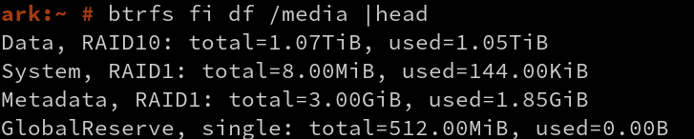
Administration
How much space am I using?
<number>

Slide 34
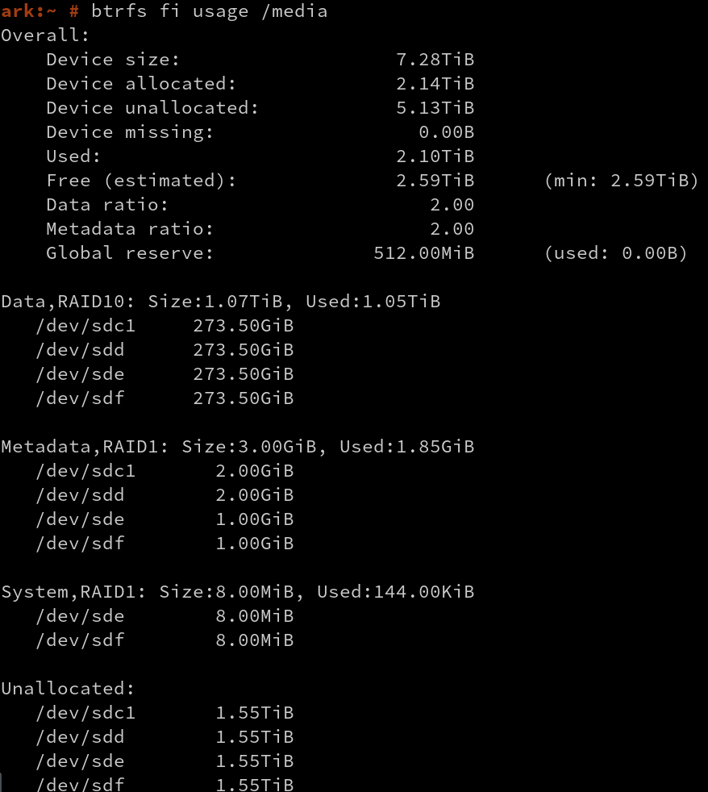
Administration
How much space am I using?
“btrfs fi df” is deprecated
Use this instead
<number>

Slide 35
Basic Features
<number>

Slide 36
Setting up a multi-disk filesystem
<number>

Slide 37
Basic Features
Setting up a multi-disk filesystem
# Create a filesystem across four drives (metadata mirrored, linear data allocation)
mkfs.btrfs /dev/sdb /dev/sdc /dev/sdd /dev/sde
<number>

Slide 38
Basic Features
Setting up a multi-disk filesystem
# Create a filesystem across four drives (metadata mirrored, linear data allocation)
mkfs.btrfs /dev/sdb /dev/sdc /dev/sdd /dev/sde
# Stripe the data without mirroring
mkfs.btrfs -d raid0 /dev/sdb /dev/sdc
<number>

Slide 39
Basic Features
Setting up a multi-disk filesystem
# Create a filesystem across four drives (metadata mirrored, linear data allocation)
mkfs.btrfs /dev/sdb /dev/sdc /dev/sdd /dev/sde
# Stripe the data without mirroring
mkfs.btrfs -d raid0 /dev/sdb /dev/sdc
# Use raid10 for both data and metadata
mkfs.btrfs -m raid10 -d raid10 /dev/sdb /dev/sdc /dev/sdd /dev/sde
<number>

Slide 40
Basic Features
Setting up a multi-disk filesystem
# Create a filesystem across four drives (metadata mirrored, linear data allocation)
mkfs.btrfs /dev/sdb /dev/sdc /dev/sdd /dev/sde
# Stripe the data without mirroring
mkfs.btrfs -d raid0 /dev/sdb /dev/sdc
# Use raid10 for both data and metadata
mkfs.btrfs -m raid10 -d raid10 /dev/sdb /dev/sdc /dev/sdd /dev/sde
# Don't duplicate metadata on a single drive (default on single SSDs)
mkfs.btrfs -m single /dev/sdb
<number>

Slide 41
Basic Features
Setting up a multi-disk filesystem
# Add a device to an existing filesystem
btrfs device add /dev/sdc /mnt
<number>

Slide 42
Basic Features
Setting up a multi-disk filesystem
# Add a device to an existing filesystem
btrfs device add /dev/sdc /mnt
# Spread the data out over all the drives
btrfs filesystem balance /
<number>

Slide 43
Basic Features
Setting up a multi-disk filesystem
# Add a device to an existing filesystem
btrfs device add /dev/sdc /mnt
# Spread the data out over all the drives
btrfs filesystem balance start /
# Convert a single-disk filesystem to a two-disk RAID1
mount /dev/sdb1 /mnt
btrfs device add /dev/sdc1 /mnt
btrfs balance start -dconvert=raid1 -mconvert=raid1 /mnt
<number>

Slide 44
Compression
<number>

Slide 45
Basic Features
Compression
ZLIB
Slower, higher compression ratio
Uses zlib level 3 compression
LZO
Faster, lower compression ratio
Will not compress files that have already been compressed at application level (such as videos, music, images, etc.)
<number>

Slide 46
Basic Features
Compression
# Mount a filesystem and enable compression
mount -o compress /dev/sdx /mnt
<number>

Slide 47
Basic Features
Compression
# Mount a filesystem and enable compression
mount -o compress /dev/sdx /mnt
# Files are compressed as accessed. Use defragmentation to access all files
btrfs filesystem defragment –c <lzo or zlib> /
<number>

Slide 48
Basic Features
Compression
# Mount a filesystem and enable compression
mount -o compress /dev/sdx /mnt
# Files are compressed as accessed. Use defragmentation to access all files
btrfs filesystem defragment –c <lzo or zlib> /
# Add the following to /etc/fstab to make the setting persistent
UUID=1a2b3c4d /home btrfs subvol=@/home,compress=<lzo or zlib> 0 0
<number>

Slide 49
Hot Add/Remove
<number>

Slide 50
Basic Features
Hot Add/Remove Disks
# Remove drive. Must be multi-disk scenario with mirroring enabled.
btrfs device remove /dev/sdc /
<number>

Slide 51
Basic Features
Hot Add/Remove Disks
# Remove drive. Must be multi-disk scenario with mirroring enabled.
btrfs device remove /dev/sdc /
# Add replacement drive
btrfs device add /dev/sdd /
<number>

Slide 52
Basic Features
Hot Add/Remove Disks
# Remove drive. Must be multi-disk scenario with mirroring enabled.
btrfs device remove /dev/sdc /
# Add replacement drive
btrfs device add /dev/sdd /
# Rebalance the filesystem to populate the new drive with data
btrfs balance start /
<number>

Slide 53
Advanced Features
<number>

Slide 54
Subvolumes
<number>

Slide 55
Advanced Features
Subvolumes
Part of the filesystem with its own independent file and directory hierarchy
LVM = Block base, BTRFS = File extent base
Subvolumes can share file extents
Snapshots are subvolumes
Accessed one of two ways
Like any other directory
Mounted separately
Allows for different mount options, i.e. – enable compression on per-subvolume basis
<number>

Slide 56
Advanced Features
Subvolumes
# Create a new subvolume for rashford home directory
btrfs subvolume create /home rashford
<number>

Slide 57
Advanced Features
Subvolumes
# Create a new subvolume for rashford home directory
btrfs subvolume create /home rashford
# Delete subvolume for rashford home directory
btrfs subvolume delete /home/rashford
<number>

Slide 58
Advanced Features
Subvolumes
# Create a new subvolume for rashford home directory
btrfs subvolume create /home rashford
# Delete subvolume for rashford home directory
btrfs subvolume delete /home/rashford
# Add to /etc/fstab to mount with different options
UUID=1a2b3c4d /home/rashford btrfs subvol=@/home/rashford,compress=lzo 0 0
<number>

Slide 59
Quotas
<number>

Slide 60
Advanced Features
Quotas
Limits can be applied to
Total data usage
Un-shared data usage
Compressed data usage
<number>

Slide 61
Advanced Features
Subvolumes
# Enable quotas for your filesystem
btrfs quota enable /
<number>

Slide 62
Advanced Features
Subvolumes
# Enable quotas for your filesystem
btrfs quota enable /
# List subvolumes on your filesystem
btrfs subvolume list /
<number>

Slide 63
Advanced Features
Subvolumes
# Enable quotas for your filesystem
btrfs quota enable /
# List subvolumes on your filesystem
btrfs subvolume list /
# Create quota for one of the subvolumes listed
btrfs qgroup limit 5G /var/log
<number>

Slide 64
Advanced Features
Subvolumes
# Enable quotas for your filesystem
btrfs quota enable /
# List subvolumes on your filesystem
btrfs subvolume list /
# Create quota for one of the subvolumes listed
btrfs qgroup limit 5G /var/log
# Remove quota from subvolume
btrfs qgroup limit none /var/log
<number>

Slide 65
Send/Receive
<number>

Slide 66
Advanced Features
Send/Receive
Used to create and maintain copies of a filesystem on local or remote systems
Send
Calculates the difference between two read-only snapshots from the same subvolume and sends it to a file or to STDOUT.
Receive
Takes the result of the send command and applies it to a snapshot.
<number>

Slide 67
Advanced Features
Send/Receive
# Create the initial snapshot for backup
btrfs subvolume snapshot -r /home /home/BACKUP
sync
<number>

Slide 68
Advanced Features
Send/Receive
# Create the initial snapshot for backup
btrfs subvolume snapshot -r /home /home/BACKUP
sync
# Backup to another portion of the local system
btrfs send /home/BACKUP | btrfs receive /backup/home
<number>

Slide 69
Advanced Features
Send/Receive
# Create the initial snapshot for backup
btrfs subvolume snapshot -r /home /home/BACKUP
sync
# Backup to another portion of the local system
btrfs send /home/BACKUP | btrfs receive /backup/home
# Backup to another portion of the local system
btrfs send /home/BACKUP | ssh root@server “btrfs receive /backup/home”
<number>

Slide 70
Advanced Features
Send/Receive
# Create the initial snapshot for backup
btrfs subvolume snapshot -r /home /home/BACKUP
sync
# Backup to another portion of the local system
btrfs send /home/BACKUP | btrfs receive /backup/home
# Backup to another portion of the local system
btrfs send /home/BACKUP | ssh root@server “btrfs receive /backup/home”
# Create a new backup snapshot and perform incremental send/receive
btrfs subvolume snapshot -r /home /home/BACKUP-new
sync
btrfs send -p /home/BACKUP /home/BACKUP-new | btrfs receive /backup/home
<number>

Slide 71
Wrap-Up
<number>

Slide 72

Key Takeaway
Not so long ago, in a datacenter not so far away...
Storage mirroring/striping (RAID), pooling/segmentation/snapshotting (LVM), backup/restore, and compression were implemented individually by separate tools
In the datacenter of today
BTRFS handles all of these functions as an integrated whole, allowing for greater flexibility without requiring the filesystem to be offline.
<number>

Slide 73
Additional Information
SUSE Storage Administration Guide for SLES 12 SP2
https://www.suse.com/documentation/sles-12/singlehtml/stor_admin/stor_admin.html#sec.filesystems.major.btrfs
Community BTRFS wiki page
https://btrfs.wiki.kernel.org/index.php/Main_Page
SUSE Coming to Windows Store in Windows 10 Fall Creators Update
https://www.suse.com/communities/blog/announcing-suse-linux-enterprise-server-available-windows-10/
SUSE Linux Enterprise Server for Raspberry Pi
https://www.suse.com/products/arm/raspberry-pi/
<number>

